Slide 1
Team 3 Better Software
Gary Johns
Dan Lain
Jose Flores

Slide 2
Overview
Vision Statement
Joel Test
Survival Test
Project Plan
Increment 2
Prototype Demo
Bug Tracking
Increment 3

Slide 3
Joel Test

Slide 4
Survival Test

Slide 5
Vision
Create a project management software tool to allow small to medium sized companies to keep track of ongoing projects, employees, and costs. This tool shall allow the company to perform resource tracking, produce cost reports, and velocity tracking. This system will be developed by a small agile team consisting of three hard working developers.

Slide 6
Project Plan

Slide 7
Increment 2 Deliverables
Project Creation
Project Management
Epic Creation
Epic Management
Story Creation
Story Management
Sprint Creation
Sprint Management
Work Recording
Work Management

Slide 8
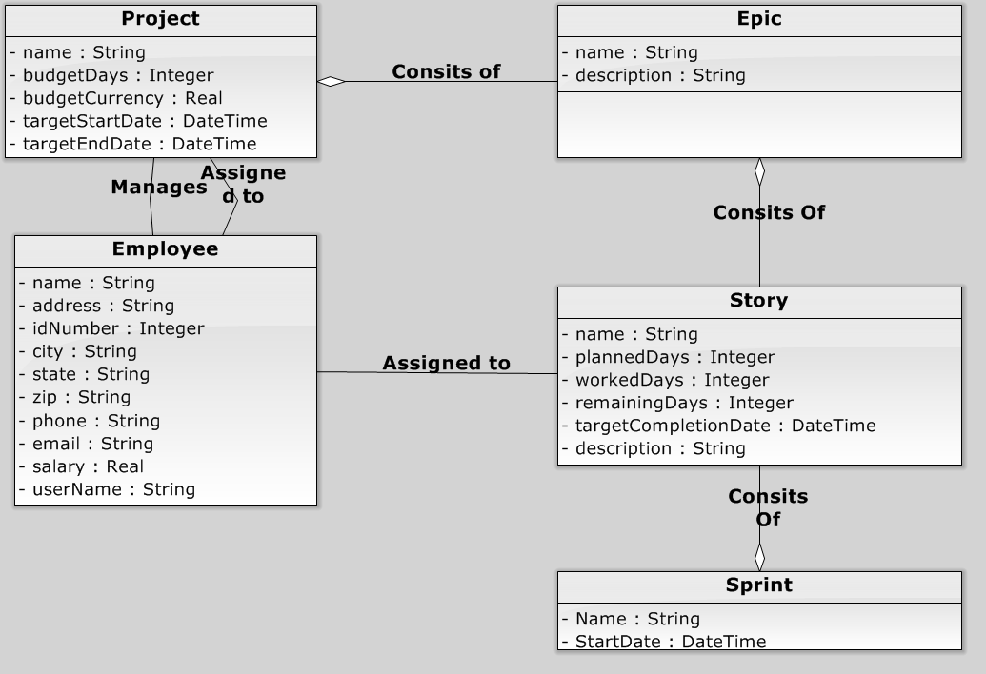
Domain Diagram

Slide 9
Rough Interface - Demo

Slide 10
Bug Tracking

Slide 11
Increment 3 Deliverables
Reports Design Layout
Reports Implement SQL
Reports Build Visualization

